Slide 1

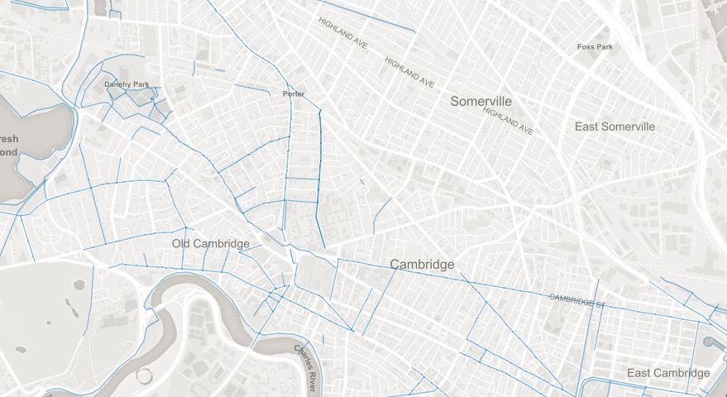
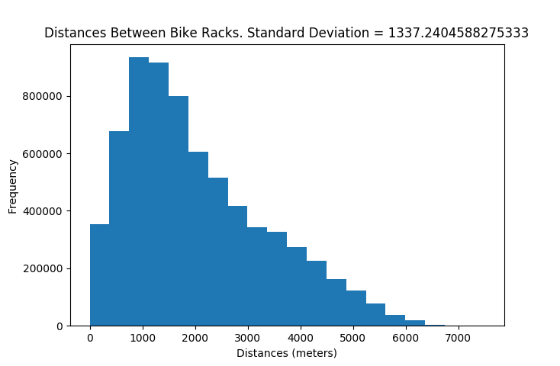
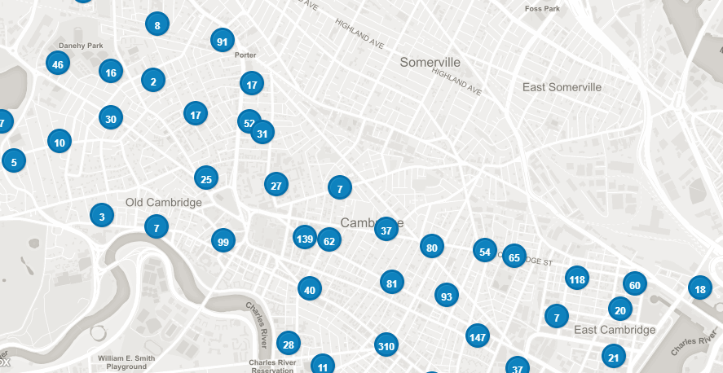
bu.edu/cs
Biking In the Cambridge Area
Jacob Levy – Cameron Sonn
Introduction
Data Sets
Analysis
Methods of environmentally safe transportation can be found in many forms, one of which is biking. We have explore datasets of public biking opportunities in the Cambridge area. Our project focuses on expanding these opportunities by pinpointing where adding in additional bike racks would provide more biking opportunities to those without them.
Boston Open Spaces
Cambridge Open Spaces
Cambridge Bike Racks
Cambridge Bike Paths
Boston Bike Paths
Found the standard deviation of the closest distances to the nearest bike racks for our data set before and after we inserted the new coordinates. Made a histogram for each of these sets and compared them. Used this to prove that we had added in the coordinates correctly. Compared all the distances from each bike rack to every other bike rack before and after we added in the new coordinates and made new histograms and found their standard deviations.
Goals/Techniques
Goals
Gather data on biking in Cambridge
Identify best locations to add in bike racks
Add in the bike racks and analyze the results
Techniques
Use public data APIs to pull data into a local MongoDB
Use relational paradigm to organize data sets by coordinate
Identify coordinates of potential new bike rack locations
Use coordinates of preexisting bike racks and potential new locations to determine the best placement
A map representing a GeoJSON file of the existing bike paths in Cambridge. Each of these paths is a representation of line string coordinates. We took these line string coordinates and found all their start and end points to determine the potential spots to add new bike racks
Future Goals
Extend the project to the Boston area
Add in data sets based on population density for more accurate results
Use results to determine environmental impact
Conclusion
We believe have identified the best locations to add new bike racks in the Cambridge area. We found that after our technique was applied, the standard deviations of bike rack distances had increased, proving our method was successful. If this technique was implemented we are confident it would help provide more biking opportunities for a wider population that previously did not have them.
GeoJSON representation of clusters of bike racks in Cambridge.

